Slide 1


RAG Force One

Slide 2


RAG FORCE ONE
Notes:
Ladies and Gentlemen Welcome on board RAG FORCE ONE, This is your captain speaking, we are ready to take off on this exciting journey of AI in 6G. "Welcome onboard RAG Force One, this is your captain speaking. We are ready to embark on an exciting journey into the future of AI in 6G. Fasten your seatbelts as we take off into the innovative skies of RAG-based chatbot technology.
Our flight path will take us through cutting-edge advancements, seamless integrations, and transformative AI solutions, designed to elevate your digital experience. Sit back, relax, and enjoy the flight, as RAG Force One navigates you to new horizons of possibilities and breakthroughs. Thank you for choosing RAG Force One, and we hope you enjoy the journey!"

Slide 3
Team
Shubham Mishra
Melvin Matthew
M. Farid Haroon

Slide 4


TEAM
SHUBHAM MISHRA
MELVIN MATTHEW
M. FARID HAROON
Notes:
Joining me today, we have an international crew from India and Pakistan, representing the Technical University of Munich and Germany that will present the topic for 7 minutes.

Slide 5
AGENDA
INTRODUCTION
RAG
USE CASES

Slide 6
AGENDA
INTRODUCTION
RAG
USE CASES

Slide 7

ELI5
Paula Protocol needs to write test cases, but she lacks the knowledge of Python Programming and Commands?
How do we solve this problem?
We introduce her to an AI expert with has knowledge of Python programming as well as SCPI commands.
All Paula needs to do now is write the test case scenario with her requirements and send it to the Chatbot.
This good chatbot then retrieves the knowledge from its databank and provides Paula with the necessary information and test code.

Slide 8
ELI5
Paula is an expert in communication protocol but needs Help!
Paula has to write test cases
She doesn’t know Python programming or SCPI commands

Slide 9
ELI5
How Do We Help Paula?
We introduce her to a smart AI friend
This AI friend knows Python programming and SCPI commands

Slide 10
ELI5
What Does Paula Do?
Paula writes down what she needs for the test in words
She sends this to the AI friend

Slide 11
ELI5
What Does the AI friend Do?
The friend looks in its big memory bank and documents
It retrieves the right information
It generates the test code for Paula

Slide 12
ELI5
Easy and Helpful!
Paula gets the test code she needs
The AI friend makes everything simple for her

Slide 13
GENERATIVE AI
Artificial Intelligence
Text
Machine Learning
Image
Deep Learning
Video
Generative AI
Tasks

Slide 14
APPROACH
Input
GenAI
Chatbot
Notes:
Utilize SCPI data sources and use generative AI to provide solutions in the form of a chatbot.

Slide 15
APPROACH
Filter
Preprocess
Embeddings
Database
LLM
Query and Inference
GUI
Input
GenAI
Chatbot
Notes:
Utilize SCPI data sources and use generative AI to provide solutions in the form of a chatbot.

Slide 16

Aim
Utilize PTE’s data sources and use generative AI to provide solutions in the form of a chatbot.
Embeddings
Database
LLM
Query and Inference
GUI
Input
Filter
Preprocess
GenAI
Chatbot

Slide 17
AGENDA
INTRODUCTION
RAG
USE CASES

Slide 18
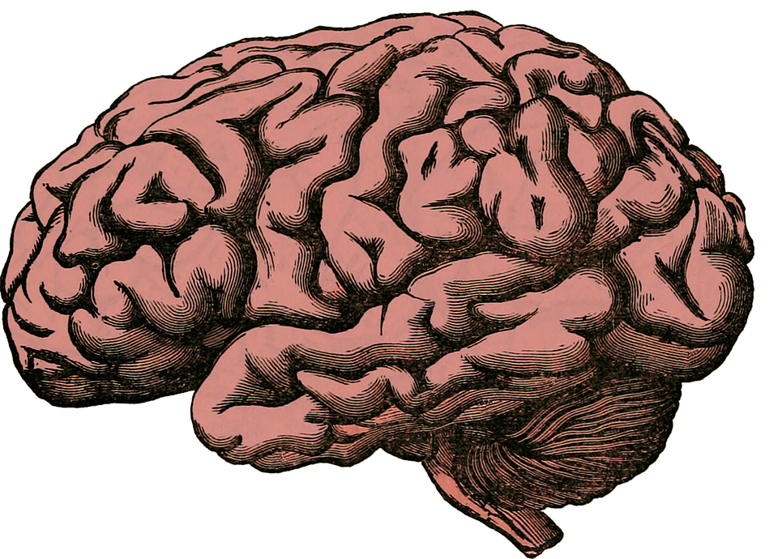
LARGE LANGUAGE MODEL
Gen-AI Transformer model
Trained on large datasets
Understand natural language

Slide 19
LARGE LANGUAGE MODEL
Applications of LLM:
Chatbots
Code Generation
Automation

Slide 20
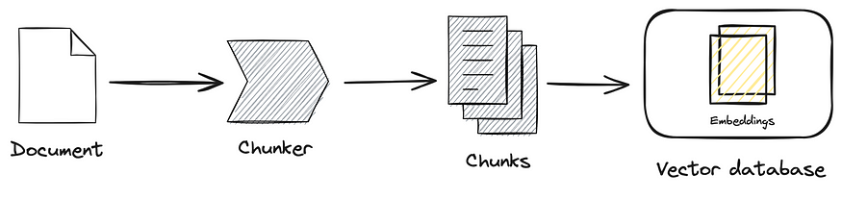
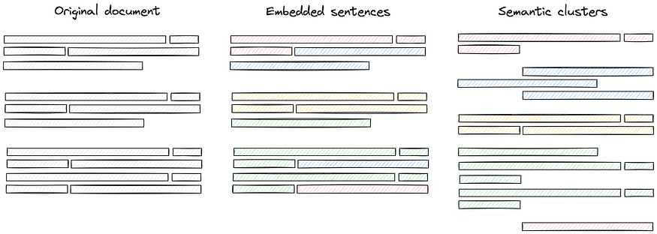
Input
Filter: Choose documents.
Preprocess:
Document
Chunker
Chunks
Vector Database
Original Document
Splitting Document
Semantic Clustering
Notes:
First thing that we need to do is to provide input files to the GenAI model. This is done in the following way, it is first filtered and then preprocessed.

Slide 21
INPUT
Filter: Choose documents
Preprocess:

Slide 22
INPUT
Example:

Slide 23
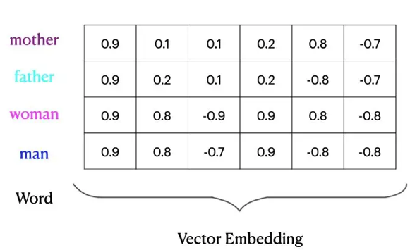
VECTOR EMBEDDINGS
What are vector embeddings?
Mathematical representations of words/phrases

Slide 24
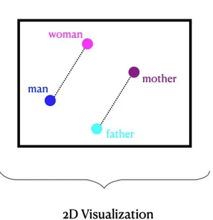
VECTOR EMBEDDINGS
Why vectors?
Language of the machines!
Efficient storage and computation!

Slide 25
Retrieval Augmented Generation
RAG involves the following high-level steps:
Augment it to your question
Generate answers from the LLM
Retrieve information from vector database

Slide 26
Retrieval Augmented Generation
No model training
Very less computational power required
Less data required
Notes:
Advantages of RAG
Cost-effective Training: Unlike intensive fine-tuning processes, RAG requires less computational power and data. You just need to index documents into the knowledge base.
Access to Various Knowledge Sources: RAG merges the knowledge within its own parameters with that from external databases. This results in more accurate answers and lessens incorrect creations, especially in tasks like question-answering.
Enhanced Scalability: RAG is adept at handling large datasets and intricate inquiries thanks to vector databases. It surpasses conventional LLMs, which are constrained by their context window size, by retrieving information from a broader range.
Challenges Faced by RAG
Risk of Hallucinations: Even RAG can make mistakes. If the database lacks certain information, the model might guess the response, which can lead to inaccuracies.
Managing Scalability: While RAG handles large databases well, increasing the database size can complicate quick and efficient data retrieval.
Potential Biases in Data: Biases in the retrieval database can taint the responses, raising ethical concerns. Fortunately, startups like Lakera are developing tools to spot and lessen biases in AI systems. By using these tools, developers and researchers can improve their models for fairer outputs.

Slide 27
Why RAG?
This does not require any model training.
Very less computational power needed as compared to training full models.
Less data required because the application does not need to be trained from scratch.
Fewer hallucinations, due to defined context and prompts.
Data Privacy, as no external cloud connections.

Slide 28

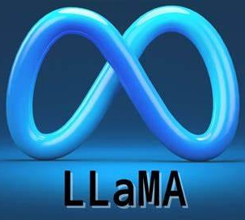



Retrieval Augmented Generation
LLM Models
Chatbot
Source Code
Retriever
6. Documents as context
7. Generated answer
Can you write me test script to test LTE attch?
Backend
1. Submit a query
4. Send query for document retrieval
8. Generated answer
5. Get retrieved documents
Sure, here is the output…
2. Query in text
3. Query in vector embeddings
Embedding Model

Slide 29




RAG: Flow Diagram
LLM Models
Chatbot
Source Code
Retriever
6. Documents as context
7. Generated answer
Backend
Hi
1. Submit a query
4. Send query for document retrieval
8. Generated answer
5. Get retrieved documents
Hi, I am your chatbot assistant.
2. Query in text
3. Query in vector embeddings
Embedding Model
Notes:
Type your message, then click on submit. This goes as step 1: the query is submitted to the backend code. Then in step 2, these queries go in text form to the embedding model. In step 3, the embedding model returns these queries and embeddings.- in step 4, these embeddings go to the retriever for fetching the relevant information from documents based on the question.

Slide 30
AGENDA
INTRODUCTION
RAG
USE CASES

Slide 31
USE CASES
PROGRAMMING
Test Program Development
Code Translation

Slide 32
USE CASES
CHATBOT
Knowledge Center
Documentation
Extract Requirements
Document Summarizer

Slide 33
QUESTIONS?

Slide 34
DEMO

Slide 35
NEXT STEPS
Improvement
RAG Pipeline
Performance
Prototype Deployment
GUI
CLOUD SERVICES
Future Plans
Generate Code
Create Documentation

Slide 36
Next Steps
Improvement
RAG Pipeline
Performance
Prototype Deployment
GUI
HICP
Future Plans
Generate Code
Create Documentation

Slide 37
Use Cases
Test Program Development
Code Translation
Modifying Existing Tools
Programming
PTE Confluence AI
Documentation AI
Chatbot
Extract Jama Requirements
Document Summarizer
Summarizer
Notes:
Now, some of the possible use cases for the RAG system can be divided into 3 main categories… firstly we have, programming, which can include TP development, code translation and modification of existing tools or source codes… Secondly, chatbot assistant in which we can have an AI assistant to guide and support on information already provided in places such as the PTE Confluence page or the TDC. And thirdly, a summarizer for either extracting requirements from JAMA or providing a summary of a large set of documents one might not have time to read.

Slide 38
RAG : Retrieval-Augmented Generation
To obtain more accurate text generation relevant to your specific data.
RAG involves the following high-level steps:
Augment it to your question
Generate answers from the LLM
Retrieve information from vector database
Notes:
Now, after having gone through the basic tools... Let‘s move on to our implementation of these tools in the form of a RAG system. This is a system to generate more relevant or accurate answers based on your specific data. Retrieval from Vector DB, Augment it to Questions, Generate answers through LLM.

Slide 39
AGENDA
INTRODUCTION
RAG
USE CASES
MARKET STRATEGY
CONCLUSION

Slide 40
MARKET STRATEGY
INTRODUCTION
RAG
USE CASES
MARKET STRATEGY
CONCLUSION

Slide 41
ALTERNATIVE SOLUTION
Notes:
Fine tuning

Slide 42


RAG VS FINE-TUNING
ASPECT | RAG | FINE-TUNING
DYNAMIC DATA
STATIC DATA
INTERNAL DATA
REDUCE HALLUCINATIONS
TRANSPERANCY IN GENERATION
FINE TUNING SMALLER MODEL
BRAND VOICE IN GENERATION
Notes:
https://www.rungalileo.io/blog/optimizing-llm-performance-rag-vs-finetune-vs-both?utm_medium=email&_hsenc=p2ANqtz-_z1tLC6khXh6SdVv4LGBcdujBoakLe9HXFfNC-a6yvSRgl0Wek3YytTIrVSbtSizxDSHSocG_jUBpHaBR7Iss-NwjQug&_hsmi=303479899&utm_content=303479899&utm_source=hs_automation

Slide 43
CONCLUSION
INTRODUCTION
RAG
USE CASES
MARKET STRATEGY
CONCLUSION

Slide 44
AGENDA
INTRODUCTION
RAG
USE CASES
MARKET STRATEGY
CONCLUSION

Slide 46
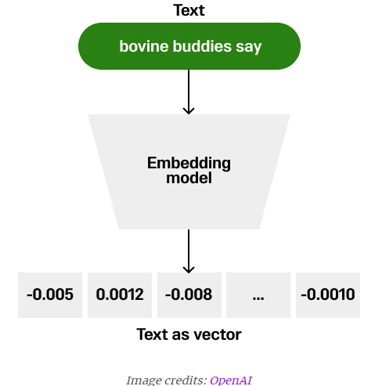
Vector Embeddings
What are vector embeddings?
Mathematical representations of words/phrases
Why vectors?
Language of the machines!
Efficient storage and computation!
How?
An Embedding model (based on AI techniques)
Capture semantic meaning and context.
Notes:
These data chunks are then converted into vector embeddings for further storage and processing.
From this, the question arises... What are vector embeddings? Vector embeddings are mathematical representations of words or phrases.
Again, you might ask... Why vectors? This is because it is the language of the machines and they allow us to be able to quantify sentences from the English language for efficient storage, computation and comparison!
How this is achieved is through an embedding model based on AI techniques which can capture the semantic meaning of the document chunks.
Take the example on the right... This 3 word sentence can be passed through an embedding model in-order to generare a vector.

Slide 47

Vector Embeddings
Example:
Notes:
Now, let‘s go a bit deeper on how such vector embeddings work. On the X-axis you can see different categories at each index, namley, alive, mammal, gender etc. Now, with each word on the Y-axis, the indexes are populated with a number determining the correlation of the input with the category of that index.
Because of this, we are able to achieve a database of higher dimensional vectors!
Now, to utilize and compare them, we can use certain distance metrics to evaluate how far is each vector from another in terms of the meaning they represent.
In the example on the right, a 2-dimensional space can visualize these distances better.
So, if you input the word ‚boy‘ in the system, then the algorithm will determine it closer to ‚man‘ rather than woman in this case and select its nearby neighbouring vectors for further processing.

Slide 48

It’s a machine’s ability to perform some cognitive functions we usually associate with humans.

